Slide 1
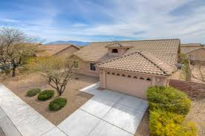
A3 Tucson Housing Regressor
1
Contributors: Jason Spaw

Slide 2
Objective:
2
Develop price predictor for home prices in Tuscon.
Models:
SLR
KNN Classifier
KNN Regressor
Multivariate Regressor

Slide 3
Feature Engineering
3
clean_house['age'] = 2024 - clean_house.year_built ← Provide better correlation than year_built
clean_house['inv_age'] = 1 / clean_house.age ← Provide better correlation than year_built
clean_house['price_sqft'] = clean_house.sold_price/clean_house.sqrt_ft ← For Bins
clean_house['house_bin'] = clean_house.price_sqft//100 ← Bins for KNN Classifier
clean_house['log_price'] = np.log(clean_house.sold_price) ← Heteroskedastic
clean_house['log_sqft'] = np.log(clean_house.sqrt_ft) ← Heteroskedastic

Slide 4
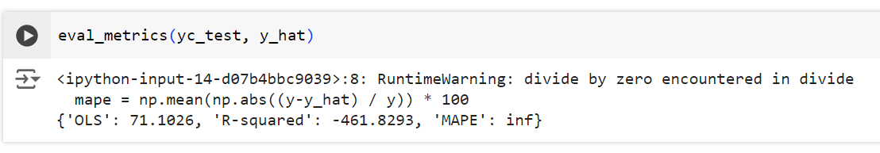
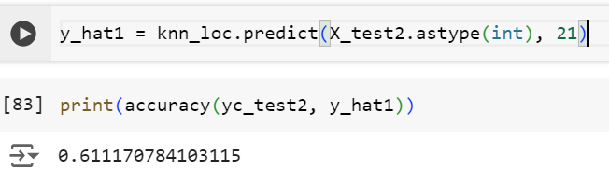
Results:
4
Simple/Fast Linear Regression (SLR):
KNN Classifier:

Slide 5
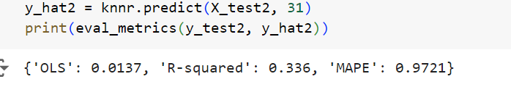
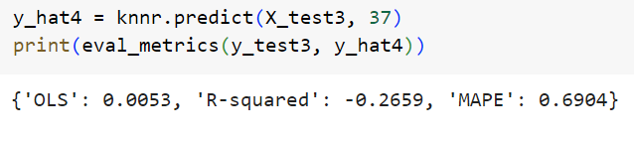
Results:
5
KNN Regressor:
Trial set:

Slide 6
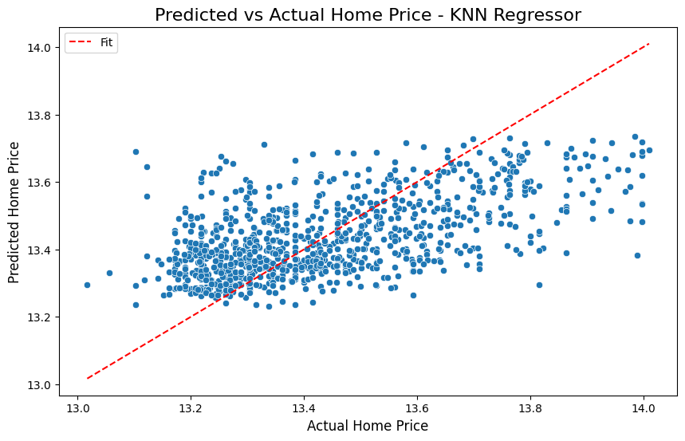
6

Slide 7
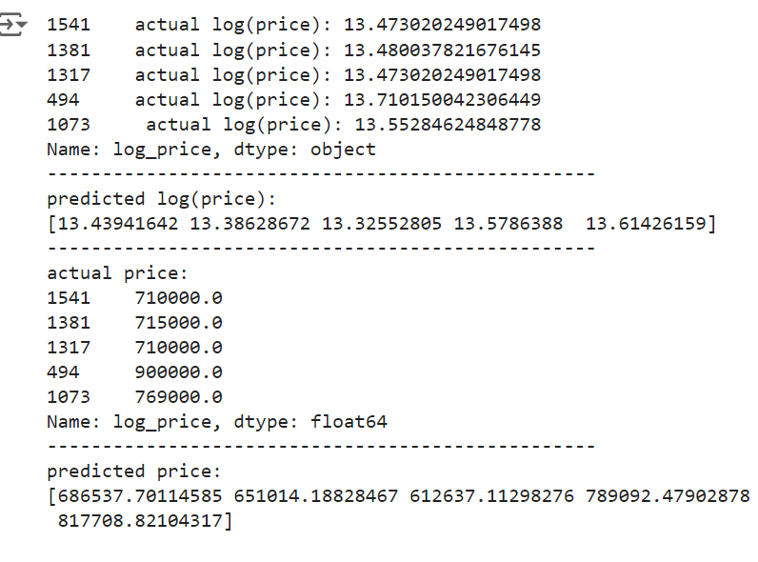
Results:
7
KNN Regressor (Continued):

Slide 8
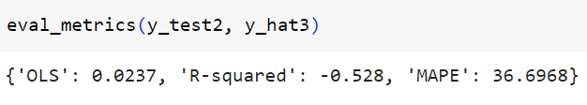
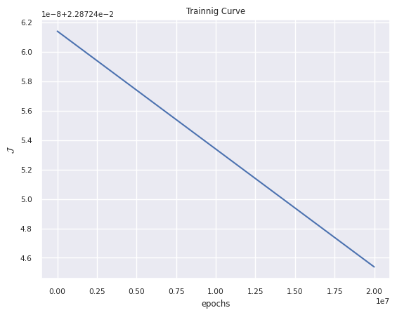
Results:
8
Multivariate Regressor:

Slide 9
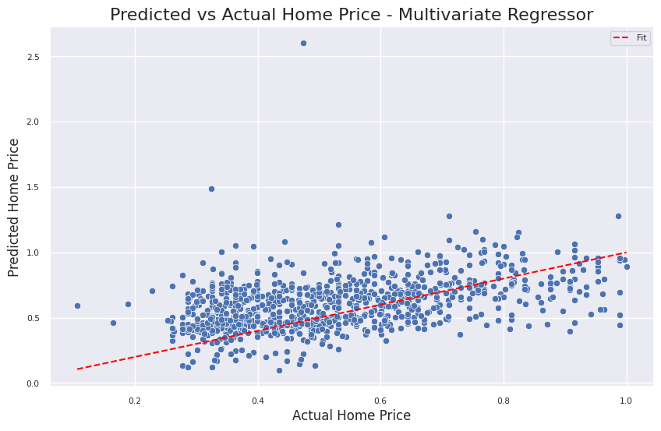
Results:
9
Multivariate Regressor (Continued):

Slide 10
Conclusion
10
Feature Engineering:
age
Inv_age
Price_sqft
House_bin
Log_price
log_sqft
Models Explored:
SLR
KNN Classifier
KNN Regressor
Multivariate Regressor
Found Most Viable: KNN Regressor

Slide 11
11
Questions?

Slide 12
12
Thank You

